Slide 1


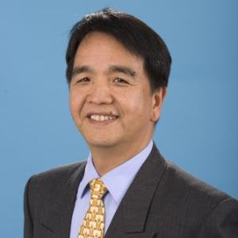
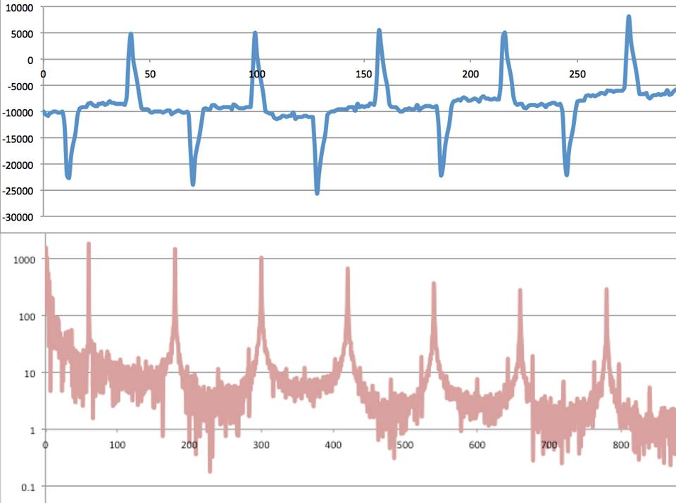

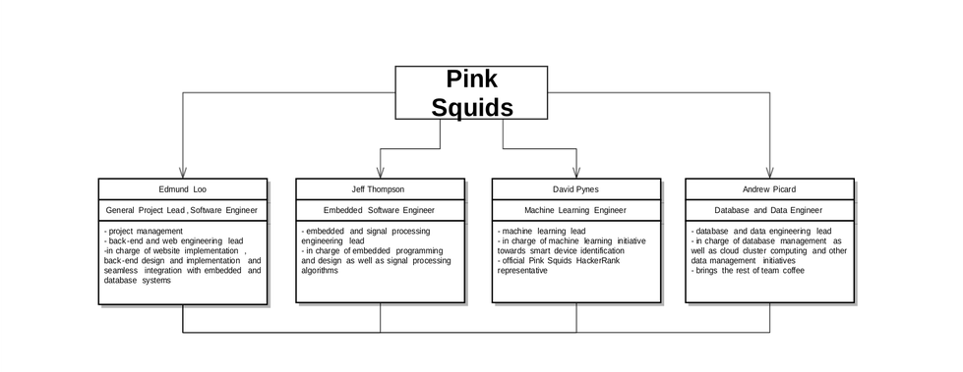
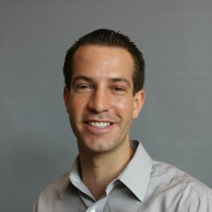
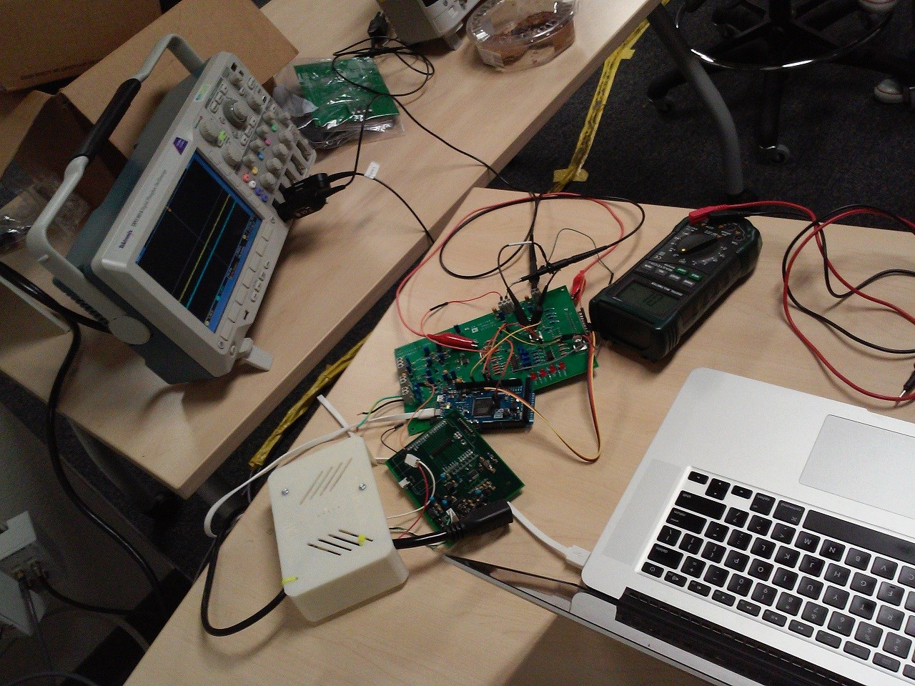
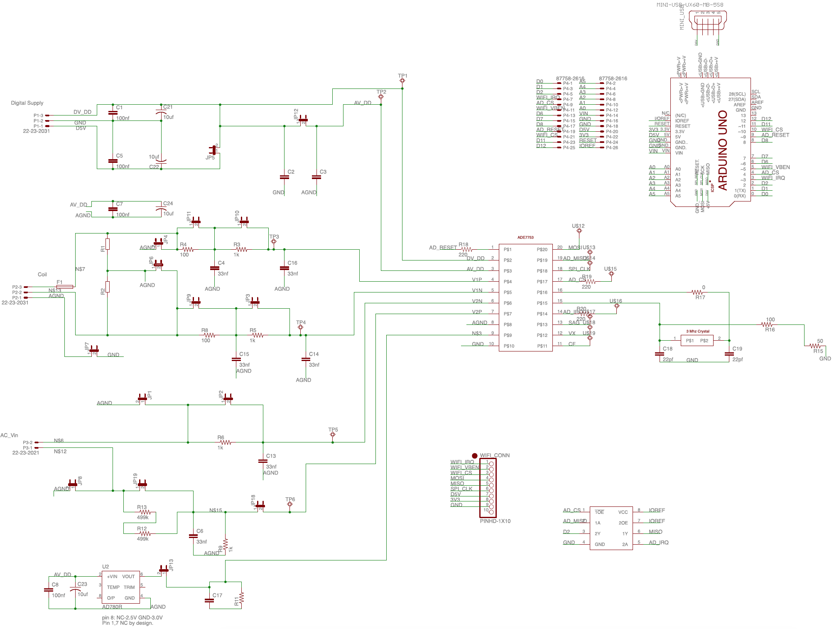


SparkyStrip
A power strip built to raise energy awareness.
MEET THE TEAM
GOAL
PROGRESS
SCHEDULE
At SparkyStrip, we believe that the first step to any kind of change is awareness. One of our planet’s most pivotal problems is the issue of energy usage and energy consumption. Energy isn’t infinite and is often destructive to produce. In order to slow down the demise of our planet and all the life on it as much as possible, energy must be conserved whenever possible. As a way to encourage this notion, our team has invented a power strip that will allow users to plug in any device and check on a web or mobile application the time the device was plugged in, the energy consumed by the device, and what the power strip identified the device to be. This way, users can be constantly aware of what devices are plugged in, what devices are consuming energy, and the amount of energy each device is pulling. Making the consumer aware of the energy consumed is a great way to get them to unplug devices, turn off devices, and conserve more energy through making them aware of how much energy many devices consume when left on or even just left plugged in.
We’ve completed an initial prototype so far that is capable of accepting a single device, reading the values that are required to calculate power consumption, identify the device, as well as the time the device was plugged in. A prototype database was also put together to show the our networking and back-end is functioning correctly. Essentially, we've already implemented all of our core functionalities aside from device identification. We plan to continue to revise and refine our core functionalities as well as implement our remaining features over the next quarter.
January bring tools together including database, web server, connectivity, sample collections, and previous testing. Milestone one Producing a consistent application signature.
March analysis of problems and pitfalls including implementing new machine learning techniques, overcoming sampling issues, clustering inconsistencies, and hardware malfunction. Milestone two Server communications established. Signatures pushed to database.
April team implementing design, testing appliances on Sparky Strip, and grow data set of signatures. Milestone three clean code, comment, and articulate clear concise logic.
June compile results, flush out front end application, and prepare for presentation. Milestone four develop a intuitive and friendly UI.
G.P. Li
Director of the California Plug Load Research Center, Mentor
HIGH LEVEL DESIGN
TEAM ORGANIZATION
Table 1. Label in 20pt Calibri.
Linyi Xia
Research Specialist at California Plug Load Research Center,
Technical Advisor
Our embedded system (SparkyStrip) determines the power, power factor, and samples the current waveform. This current waveform is converted to the frequency domain where the harmonics are determined. These harmonics and the macro power consumption form the unique characteristics of each device plugged into our strip. These characteristics are sent to our server over Wi-Fi where they are loaded into our database and machine learning is used to identify what the plugged-in device is. We will begin with identifying single devices then expand to many at once.
Time Domain
David Pynes
Computer Science and Engineering Major,
Machine Learning Engineer
Frequency Domain
Figure 2. Waveforms of a LCD monitor
Andrew Picard
Computer Science and Engineering Major,
Database Engineer
INNOVATIONS
-Device identification with no user programming .
-Minimal user interaction required.
-Gathers data based off their unique signatures.
-Data logged showing history of usage
-Creates energy awareness.
-Makes use of machine learning.
-Cloud based so physical device never needs upgrading.
-Promotes energy conservation.
-Unique product (nothing similar exists)
-Has the power to makes the world a better place.
Jeffrey Thompson
Computer Science and Engineering Major,
Embedded Systems Engineer
Edmund Loo
Computer Science and Engineering Major,
Project Lead and Software Engineer
WEB SITE
Follow this link to find more information on the Sparky Strip: https://sites.google.com/a/uci.edu/eecs-cse-srproj-15-16/team39
Figure 1. In lab device testing.
Figure 3. Schematic of arduino daughter board

